Slide 1











Ansible
For the Absolute Beginner

Slide 2






The Course
R e d H a t A n s i b l e f o r B e g i n n e r s
Introduction to Ansible
Setting up Ansible on VirtualBox
Introduction to YAML
Inventory Files
Playbooks Variables
Conditionals Loops
Roles

Slide 3

Note
Do not copy code from this file directly as it may affect the formatting.
Always refer to git repositories to access code.

Slide 4


Ansible
Introduction

Slide 5








Why Ansible?
Configuration Management
Continuous Delivery
Application Deployment
Security Compliance
Provisioning
Time
Coding Skills
Maintenance
Simple
Powerful
Agentless
Scripts

Slide 6
Scripts
vs Ansible Playbook
#!/bin/bash
# Script to add a user to Linux system if [ $(id -u) -eq 0 ]; then
$username=johndoe
read -s -p "Enter password : " password egrep "^$username" /etc/passwd >/dev/null if [ $? -eq 0 ]; then
echo "$username exists!"
exit 1 else
useradd -m -p $password $username
[ $? -eq 0 ] && echo "User has been added to system!" || echo "Failed to add a user!"
fi
fi
- hosts: all_my_web_servers_in_DR tasks:
- user:
name: johndoe
all_my_db_servers
all_my_web_servers_on_cloud
localhost

Slide 7




Use case example - Simple

Slide 8



Use case example - complex

Slide 9


Use case example - complex

Slide 10
Ansible Documentation
https://docs.ansible.com/ansible/latest/index.html

Slide 11

Ansible
Install

Slide 12





Control Node
Redhat or CentOS –
$ sudo yum install ansible
Fedora –
$ sudo dnf install ansible
Ubuntu –
$ sudo apt-get install ansible
Ansible Control Machine
Playbooks
Inventory
Modules
PIP –
$ sudo pip install ansible
Additional Options:
Control Machine - Linux Only
Install from source on GIT
Build RPM yourself
https://docs.ansible.com/ansible/latest/installation_guide/

Slide 13
Install Control Node on Redhat or CentOS
Redhat or CentOS –
$ sudo yum install ansible

Slide 14
Install via PIP
Install pip if not present
$ sudo yum install epel-release
$ sudo yum install python-pip
Install Ansible using pip
Upgrade Ansible using pip
$ sudo pip install ansible
$ sudo pip install --upgrade ansible
Install Specific Version of Ansible using pip
$ sudo pip install ansible==2.4

Slide 15





DEMO

Slide 16

Ansible
Inventory

Slide 17


inventory
server1.company.com server2.company.com
[mail] server3.company.com server4.company.com
[db] server5.company.com server6.company.com
[web] server7.company.com server8.company.com
server1.company.com
server2.company.com
server1.company.com
server2.company.com
[mail] server3.company.com server4.company.com
Linux – SSH
Windows – Powershell Remoting
inventory
/etc/ansible/hosts
Agentless

Slide 18
More on inventory files
#Sample Inventory File
server1.company.com server2.company.com server3.company.com server4.company.com
ansible_connection=ssh ansible_connection=winrm ansible_connection=ssh ansible_connection=winrm
ansible_user=root ansible_user=admin ansible_ssh_pass=P@#
localhost ansible_connection=localhost
Inventory Parameters:
Security: Ansible Vault
ansible_connection – ssh/winrm/localhost
ansible_port – 22/5986
ansible_user – root/administrator
ansible_ssh_pass – Password
ansible_ssh_private_key_file – Key File

Slide 19
Coding Exercise
Create a folder called playbooks
Move your pem file into this folder by running mv ansible.pem playbooks/
Create an inventory file and add the following: target1 <Target_IP_Address> ansible_ssh_user=ec2-user ansible_ssh_private_key_file=ansible.pem

Slide 20

Ansible
Playbooks

Slide 21
Ansible playbooks
# Simple Ansible Playbook
Run command1 on server1
Run command2 on server2
Run command3 on server3
Run command4 on server4
Run command5 on server5
Run command6 on server6
Run command7 on server7
Run command8 on server8
Run command9 on server9
Restarting Server1
Restarting Server2
Restarting Server3
Restarting Server4
Restarting Server5
Restarting Server6
Restarting Server7
# Complex Ansible Playbook
Deploy 50 VMs on Public Cloud
Deploy 50 VMs on Private Cloud
Provision Storage to all VMs
Setup Network Configuration on Private VMs
Setup Cluster Configuration
Configure Web server on 20 Public VMs
Configure DB server on 20 Private VMs
Setup Loadbalancing between web server VMs
Setup Monitoring components
Install and Configure backup clients on VMs
Update CMDB database with new VM Information

Slide 22
Playbook
YAML format
Playbook – A single YAML file
Play – Defines a set of activities (tasks) to be run on hosts
Task – An action to be performed on the
host
Execute a command
Run a script
Install a package
Shutdown/Restart
playbook.yml
-
name: Play 1
hosts: localhost
tasks:
- name: Execute command ‘date’
command: date
- name: Execute script on server
script: test_script.sh
- name: Install httpd service yum:
name: httpd state: present
- name: Start web server
service: name: httpd
state: started

Slide 23
Playbook format
playbook.yml
-
name: Play 1
hosts: localhost
tasks:
name: Execute command ‘date’
command: date
name: Execute script on server script: test_script.sh
 | -
name: Play 2 hosts: localhost tasks:
 |  | name: Install web service yum: name: httpd state: present name: Start web server service: name: httpd state: started

Slide 24
Hosts
playbook.yml
-
name: Play 1
tasks:
name: Execute command ‘date’
command: date
name: Execute script on server script: test_script.sh
name: Install httpd service
yum:
name: httpd state: present
name: Start web server service:
name: httpd
state: started
inventory
localhost
server1.company.com server2.company.com
[mail] server3.company.com server4.company.com
[db] server5.company.com server6.company.com
[web] server7.company.com server8.company.com
hosts: localhost

Slide 25
Modules
Ansible modules are units of code that can control system resources or execute system commands. Ansible provides a module library that you can execute directly on remote hosts or through playbooks.

Slide 26
module
playbook.yml
-
ansible-doc -l
name: Play 1 hosts: localhost tasks:
- name: Execute command ‘date’
command:
date
- name: Execute script on server
script:
test_script.sh
- name: Install httpd service
yum:
name: httpd
state: present
- name: Start web server
service:
name: httpd
state: started

Slide 27

Run
Execute Ansible Playbook
Syntax: ansible-playbook <playbook file name>
ansible-playbook playbook.yml
ansible-playbook --help

Slide 28

Ansible
Modules

Slide 29
modules
System
Commands
Files
Database
Cloud
Windows
More..

Slide 30
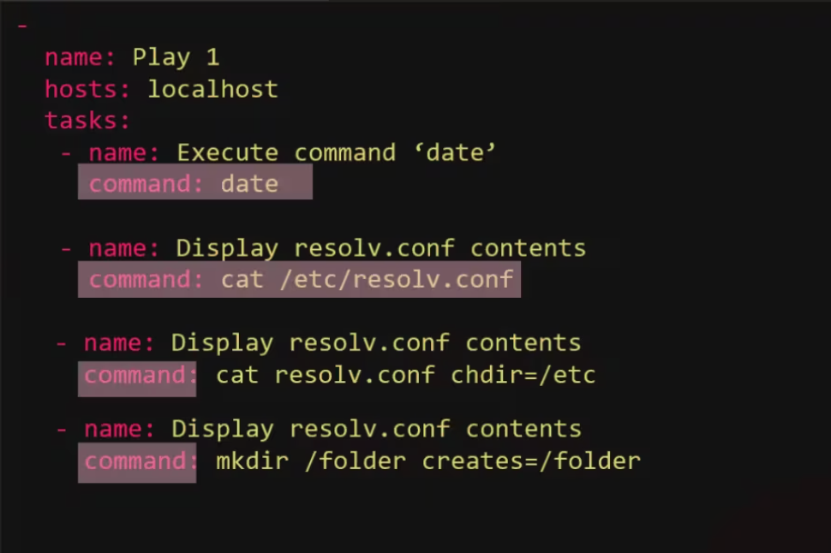
command
Executes a command on a remote node
playbook.yml
-
parameter | comments
chdir | cd into this directory before running the command
creates | a filename or (since 2.0) glob pattern, when it already exists, this step will not be run.
executable | change the shell used to execute the command. Should be an absolute path to the executable.
removes | a filename or (since 2.0) glob pattern, when it does not exist, this step will not be run.
warn (added in 1.8) | if command warnings are on in ansible.cfg, do not warn about this particular line if set to no/false.
free_form the command module takes a free form command to run. There is no
parameter actually named 'free form'. See the examples!
- name: Copy file from source to destination
copy: ssrrcc==//ssoouurrccee__ffiillee ddeesstt==//ddeessttiinnaattiioonn

Slide 31


script
Runs a local script on a remote node after transferring it
playbook.yml
-
name: Play 1 hosts: localhost tasks:
- name: Run a script on remote server
Copy script to remote systems
Execute script on remote systems
script: /some/local/script.sh -arg1 -arg2
Scripts

Slide 32
Service
Manage Services – Start, Stop, Restart
playbook.yml
playbook.yml
-
-
name: Start Services in order hosts: localhost
tasks:
- name: Start the database service
name: Start Services in order hosts: localhost
tasks:
- name: Start the database service
service: name=postgresql state=started
service:
name: postgresql state: started
name: Start the httpd service
service: name=httpd state=started
name: Start the nginx service service:
name: nginx state: started

Slide 33
idempotency
Why “started” and not “start”?
“Start” the service httpd ”Started” the service httpd
Ensure service httpd is started
If httpd is not already started => start it If httpd is already started, =>do nothing

Slide 34
lineinfile
Search for a line in a file and replace it or add it if it doesn’t exist.
/etc/resolv.conf
nameserver 10.1.250.1
nameserver 10.1.250.2
nameserver 10.1.250.10
playbook.yml
script.sh
-
#Sample script
echo “nameserver 10.1.250.10” >> /etc/resolv.conf
name: Add DNS server to resolv.conf
hosts: localhost tasks:
- lineinfile:
path: /etc/resolv.conf
line: 'nameserver 10.1.250.10'
/etc/resolv.conf
/etc/resolv.conf
nameserver 10.1.250.1
nameserver 10.1.250.2
nameserver | 10.1.250.1 | nameserver | 10.1.250.10
nameserver | 10.1.250.2 | nameserver | 10.1.250.10
nameserver | 10.1.250.10 | nameserver | 10.1.250.10

Slide 35

Ansible
Variables

Slide 36
Variable
Stores information that varies with each host
inventory
Web1 ansible_host=server1.company.com ansible_connection=ssh ansible_shh_pass=P@ssW db ansible_host=server2.company.com ansible_connection=winrm ansible_shh_pass=P@s Web2 ansible_host=server3.company.com ansible_connection=ssh ansible_shh_pass=P@ssW
Playbook.yml
variables
-
variable1: value1 variable2: value2
name: Add DNS server to resolv.conf
hosts: localhost
vars:
dns_server: 10.1.250.10 tasks:
- lineinfile:
path: /etc/resolv.conf
line: 'nameserver 10.1.250.10'

Slide 37
Using variables
Playbook.yml
-
name: Add DNS server to resolv.conf hosts: localhost
vars:
dns_server: 10.1.250.10
tasks:
- lineinfile:
path: /etc/resolv.conf
line: 'nameserve
{{ dns_server }}’
r 10.1.250.10'

Slide 38
-
-
name: Set Firewall Configurations hosts: web
tasks:
- firewalld:
service: https permanent: true state: enabled
- firewalld:
port:8081/tcp permanent: true state: disabled
- firewalld:
port: 161-162/udp permanent: true state: disabled
- firewalld:
source: 192.0.2.0/24 Zone: internal state: enabled
#Sample Inventory File
Web http_port=8081 snmp_port=161-162
name: Set Firewall Configurations hosts: web
tasks:
- firewalld:
service: https permanent: true state: enabled
inter_ip_range=192.0.2.0
#Sample variable File – web.yml
http_port: 8081
snmp_port: 161-162
inter_ip_range: 192.0.2.0
- firewalld:
port: permanent: true state: disabled
‘{{ http_port }}’
/tcp
- firewalld: port:
permanent: true
state: disabled
‘{{ snmp_port }}’
/udp
{{ }}
Jinja2 Templating
- firewalld:
source:
Zone: internal state: enabled
’/24
‘{{ inter_ip_range }}
source: {{ inter_ip_range }}
source: ‘{{ inter_ip_range }}’
source: SomeThing{{ inter_ip_range }}SomeThing

Slide 39

Ansible
Loops

Slide 40
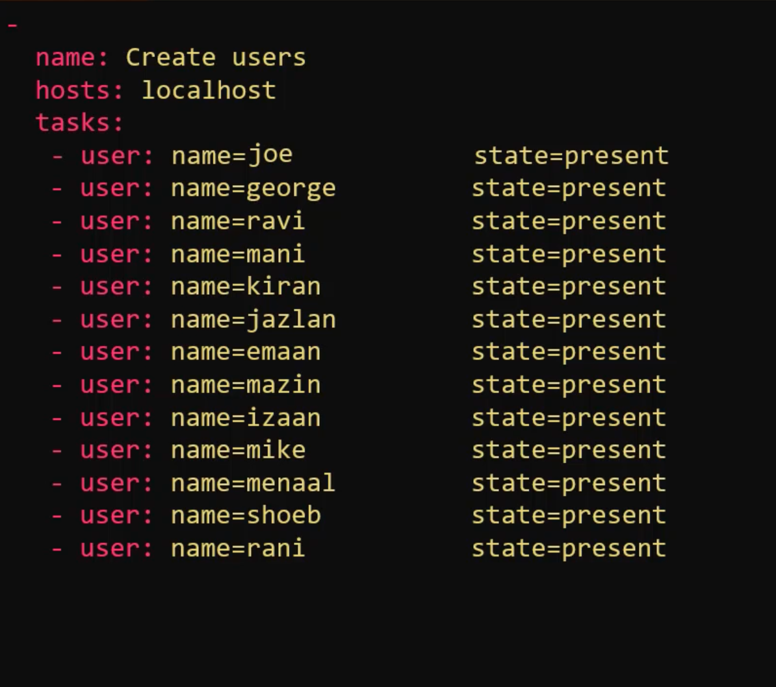
LOOPS
I want to create multiple users. One way to do it is to put all users as shown in the image

Slide 41
LOOPS - Visualize
-
-
name: Create users hosts: localhost tasks:
user: name=‘{{ item }}’
loop:
joe
george
ravi
mani
kiran
jazlan
emaan
mazin
izaan
mike
menaal
shoeb
rani
name: Create users hosts: localhost tasks:
state=present
- var: item=
user: name= “{{ item }}”
state=present
- var: item=
user: name= “{{ item }}”
state=present
- var: item=
user: name= “{{ item }}”
state=present
- var: item=
user: name= “{{ item }}”
state=present
- var: item=
user: name= “{{ item }}”
state=present
- var: item=
user: name= “{{ item }}”
state=present
- var: item=
user: name= “{{ item }}”
state=present
- var: item=
user: name= “{{ item }}”
state=present
- var: item=
user: name= “{{ item }}”
state=present

Slide 42
LOOPS - Visualize
-
-
name: Create users hosts: localhost tasks:
user: name=‘{{ item }}’
loop:
joe
george
ravi
mani
kiran
jazlan
emaan
mazin
izaan
mike
menaal
shoeb
rani
name: Create users hosts: localhost tasks:
state=present
var: item=joe
user: name= “{{ item }}”
var: item=george
user: name= “{{ item }}”
var: item= ravi
user: name= “{{ item }}”
var: item= mani
user: name= “{{ item }}”
var: item= kiran
user: name= “{{ item }}”
state=present
state=present
state=present
state=present
state=present
- var:
item= jazlan
user: name= “{{ item }}” state=present
- var: item= emaan
user: name= “{{ item }}” state=present
- var:
item= mazin
user: name= “{{ item }}” state=present
- var: item= izaan
user: name= “{{ item }}” state=present

Slide 43
LOOPS - Visualize
-
-
name: Create users hosts: localhost tasks:
- user: name ‘{{ ???? }}’
loop:
name: joe uid: 1010
name: george uid: 1011
name: ravi uid: 1012
name: kiran uid: 1014
name: jazlan uid: 1015
name: emaan uid: 1016
name: izaan uid: 1018
name: Create users hosts: localhost tasks:
state=present
uid= ‘{{ ? }}’
=‘{{ item }}’
100
- var: item=joe
- joe 1010
- george1011
- ravi 1012
- mani 1013
- kiran 1014
- jazlan1015
- emaan 1016
- mazin 1017
- izaan 1018
- mike 1019
- menaal1020
- shoeb 1021
- rani 1022
user: name= “{{ item }}”
state=present
- var: item=george
user: name= “{{ item }}”
state=present
- var: item=ravi
user: name= “{{ item }}”
state=present
- var: item=izaan
state=present
user: name= “{{ item }}”
- var: item=kiran
user: name= “{{ item }}”
state=present
- var: item=jazlan
user: name= “{{ item }}”
state=present
- var: item=emaan
user: name= “{{ item }}”
state=present

Slide 44
LOOPS - Visualize
-
-
name: Create users hosts: localhost tasks:
- var: item:
name: Create users hosts: localhost tasks:
- user: name ‘{{ ???? }}’
loop:
name: joe uid: 1010
name: george uid: 1011
name: ravi uid: 1012
name: kiran uid: 1014
name: jazlan uid: 1015
name: emaan uid: 1016
name: izaan uid: 1018
=‘{{ item }}’
statepresent uid= ‘{{ ? }}’
1010
- joe 1010
- george 1011
- ravi 1012
- mani 1013
- kiran 1014
- jazlan 1015
- emaan 1016
- mazin 1017
- izaan 1018
- mike 1019
- menaal 1020
- shoeb 1021
- rani 1022
user: name= “{{ ???? }}” state=present
- var: item:
uid=“{?}”
user: name= “{{ ???? }}” state=present uid=“{?}”
- var: item:
user: name= “{{ ???? }}” state=present uid=“{?}”

Slide 45
LOOPS - Visualize
-
-
name: Create users hosts: localhost tasks:
name: Create users hosts: localhost tasks:
- user: name ‘{{ ???? }}’
loop:
name: joe uid: 1010
name: george uid: 1011
name: ravi uid: 1012
name: kiran uid: 1014
name: jazlan uid: 1015
name: emaan uid: 1016
name: izaan uid: 1018
=‘{{ item }}’
state=present
uid= ‘{{ ? }}’
- var: item:
name: joe
uid: 1010
1010
- joe 1010
- george 1011
- ravi 1012
- mani 1013
- kiran 1014
- jazlan 1015
- emaan 1016
- mazin 1017
- izaan 1018
- mike 1019
- menaal 1020
- shoeb 1021
- rani 1022
user: name ‘{{ item.name }}’
- var: item:
state=present uid=‘{{ item.uid
= “{{ ???? }}”
“{?}”
‘{{ item.name }}’
‘{{ item.uid
name: george uid: 1011
user: name=‘{{ item.name }}’ state=present uid=‘{{ item.uid
“{{ ???? }}”
“{?}”
‘{{ item.name }}’
‘{{ item.uid
- var: item:
name: ravi
uid: 1012
user: name= ‘{{ item.name }}’ state=present
- var: item:
uid=‘{{ item.uid
“{{ ???? }}”
“{?}”
‘{{ item.name }}’
‘{{ item.uid
name: mani uid: 1013
user: name=
‘{{ item.name }}’ state=present uid
‘{{ item.uid
“{{ ???? }}”
=‘{{ item.uid
‘{{ item.name }}’
“{?}”

Slide 46
LOOPS - Visualize
-
-
name: Create users hosts: localhost tasks:
- user: name= ‘{{ item.name }}’ state=present
loop:
name: Create users hosts: localhost tasks:
uid= ‘{{ item.uid }}’
‘{{ ? }}’
- var: item:
name: joe
uid: 1010
‘{{ item }}’
1010
‘{{ ???? }}’
‘{{ item.name }}’
‘{{ item.name }}’
‘{{ item.name }}’
‘{{ item.uid }}’
‘{{ item.uid }}’
‘{{ item.uid }}’
_{- joe} 1010
- george¹⁰¹¹
- ravi ¹⁰¹²
- mani ¹⁰¹³
- kiran ¹⁰¹⁴
- jazlan¹⁰¹⁵
- emaan ¹⁰¹⁶
- mazin ¹⁰¹⁷
- izaan ¹⁰¹⁸
- mike ¹⁰¹⁹
- menaal¹⁰²⁰
- shoeb ¹⁰²¹
- rani ¹⁰²²
name: joe uid: 1010
name: george uid: 1011
name: ravi uid: 1012
name: mani uid: 1013
name: kiran uid: 1014
name: jazlan uid: 1015
name: emaan
uid: 1016
name: mazin uid: 1017
name: izaan uid: 1018
name: mike
{ name: joe, uid: 1010 }
{ name: george, uid: 1011 }
{ name: ravi, uid: 1012 }
{ name: mani, uid: 1013 }
{ name: kiran, uid: 1014 }
{ name: jazlan, uid: 1015 }
{ name: emaan, uid: 1016 }
{ name: mazin, uid: 1017 }
{ name: izaan, uid: 1018 }
{ name: mike, uid: 1019 }
user: name ‘{{ item.name }}’
- var: item:
state=present uid=‘{{ item.uid
= “{{ ???? }}”
“{?}”
name: george uid: 1011
user: name=‘{{ item.name }}’ state=present uid=‘{{ item.uid
“{{ ???? }}”
“{?}”
- var: item:
name: ravi
uid: 1012
user: name= ‘{{ item.name }}’ state=present
- var: item:
uid=‘{{ item.uid
“{{ ???? }}”
“{?}”
name: mani uid: 1013
user: name=
‘{{ item.name }}’
state=present uid=
‘{{ item.uid
“{{ ???? }}”
“{?}”

Slide 47
With_*
-
-
name: Create users hosts: localhost tasks:
user: name=‘{{ item }}’
loop:
joe
george
ravi
mani
name: Create users hosts: localhost tasks:
user: name=‘{{ item }}’
with_items:
joe
george
ravi
mani
state=present
state=present

Slide 48
With_*
-
-
name: Create users hosts: localhost tasks:
user: name=‘{{ item }}’
with_items:
joe
george
ravi
mani
name: View Config Files hosts: localhost tasks:
debug: var=item with_file:
“/etc/hosts”
“/etc/resolv.conf”
“/etc/ntp.conf”
state=present
-
-
name: Get from multiple URLs hosts: localhost
tasks:
debug: var=item with_url:
“https://site1.com/get-servers”
“https://site2.com/get-servers”
“https://site3.com/get-servers”
name: Check multiple mongodbs
hosts: localhost tasks:
debug: msg=“DB={{ item.database }} PID={{ item.pid}}”
with_mongodb:
database: dev
connection_string: “mongodb://dev.mongo/”
database: prod
connection_string: “mongodb://prod.mongo/”

Slide 49
With_*
with_items with_file with_url with_mongodb
with_dict with_etcd with_env with_filetree With_ini
With_inventory_hostnames With_k8s
With_manifold With_nested With_nios With_openshift With_password With_pipe With_rabbitmq
With_redis With_sequence With_skydive With_subelements With_template With_together With_varnames

Slide 50

Ansible
Conditionals

Slide 51


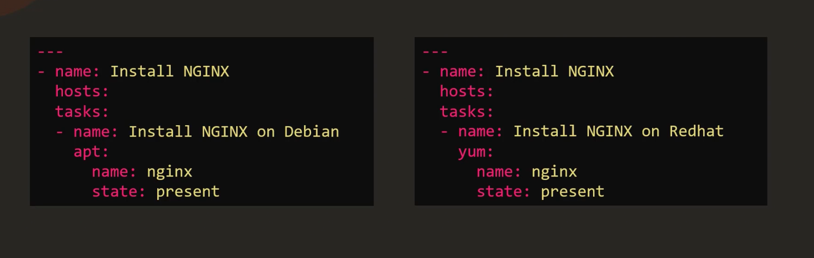
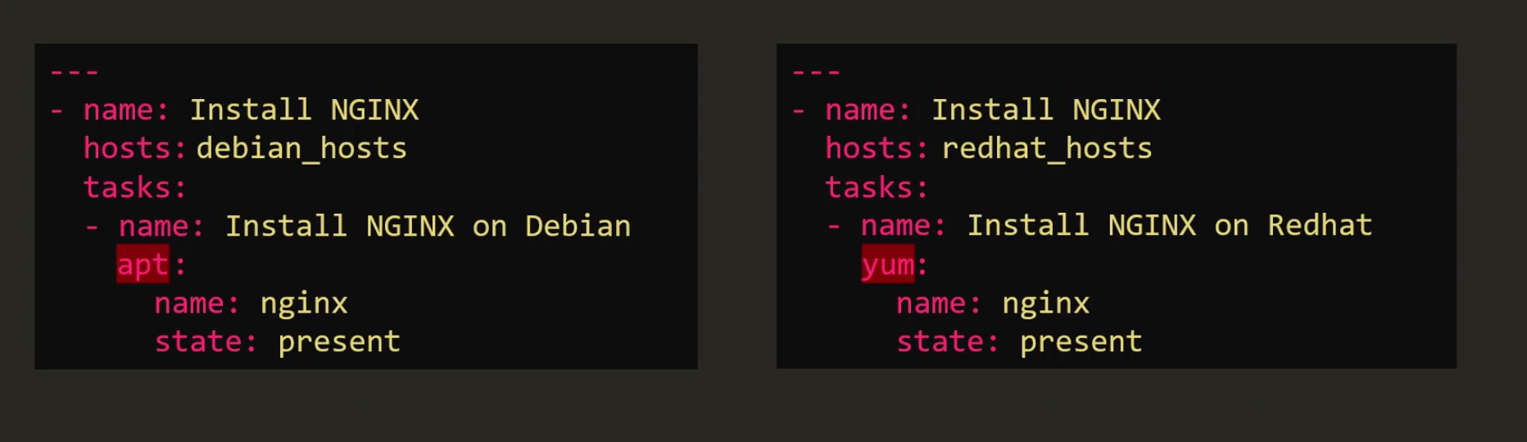
I am writing a playbook to run Nginx on Debian and RHEL based systems

Slide 52
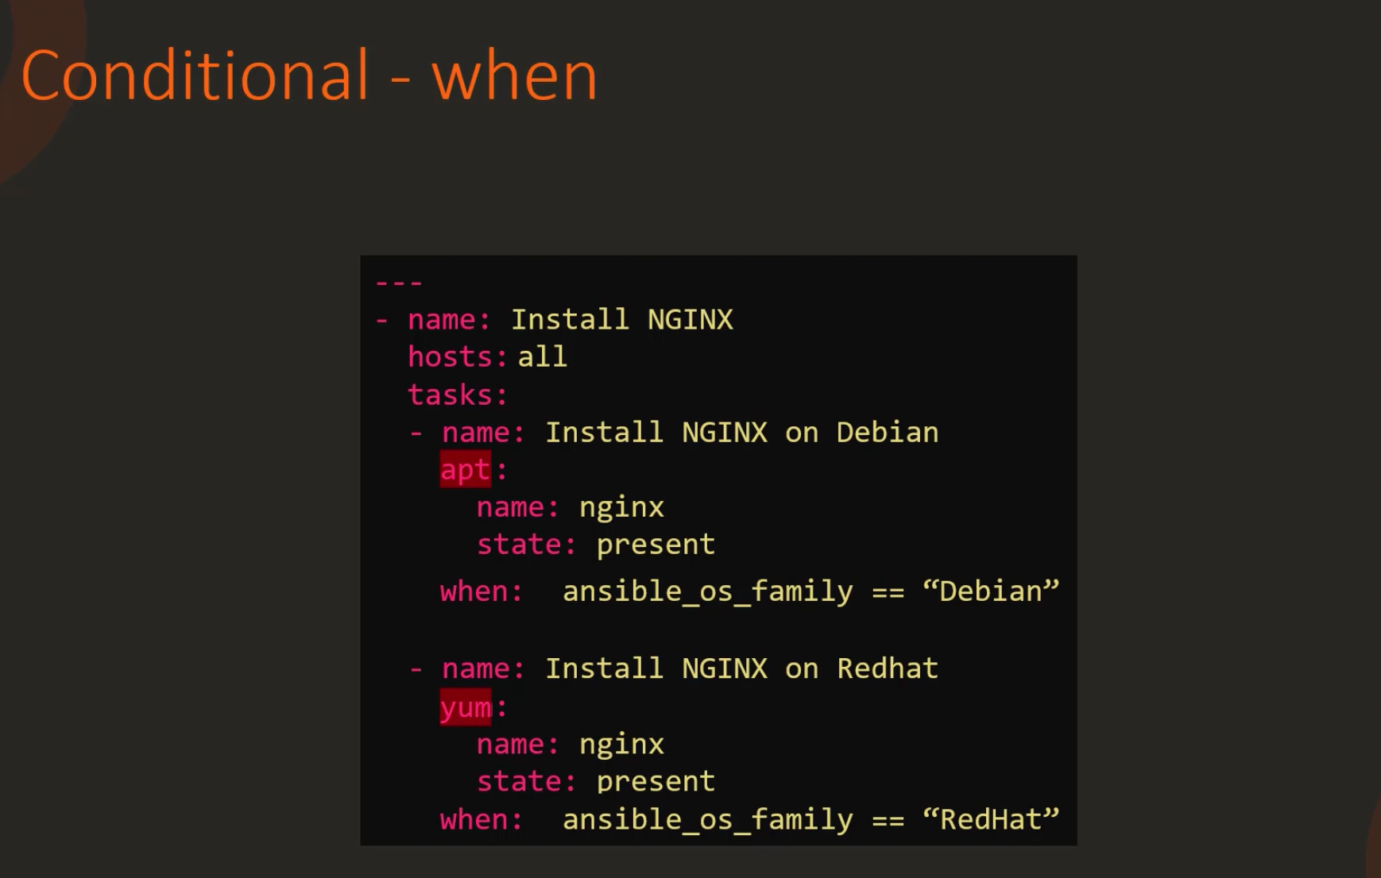
But I want a single playbook for both the scenarios. So I’ll use a conditional statement to verify if it matches a condition and only if it is true we will execute it.

Slide 53
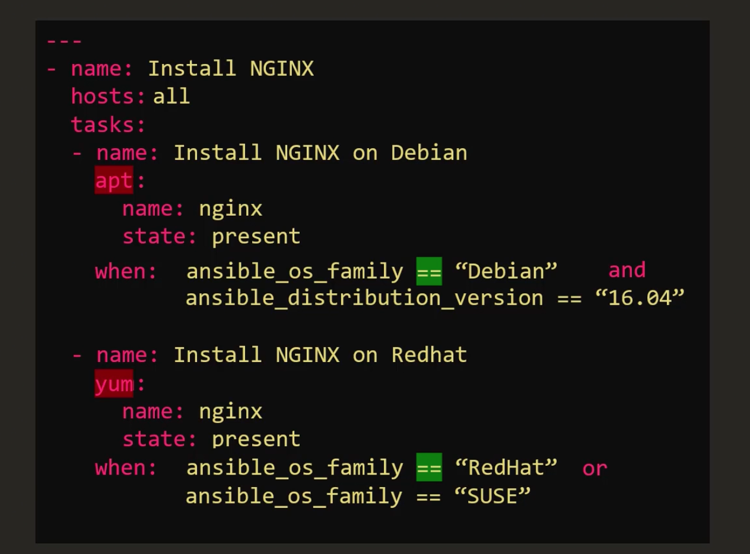
I can use Conditionals Like “and” “Or”

Slide 54
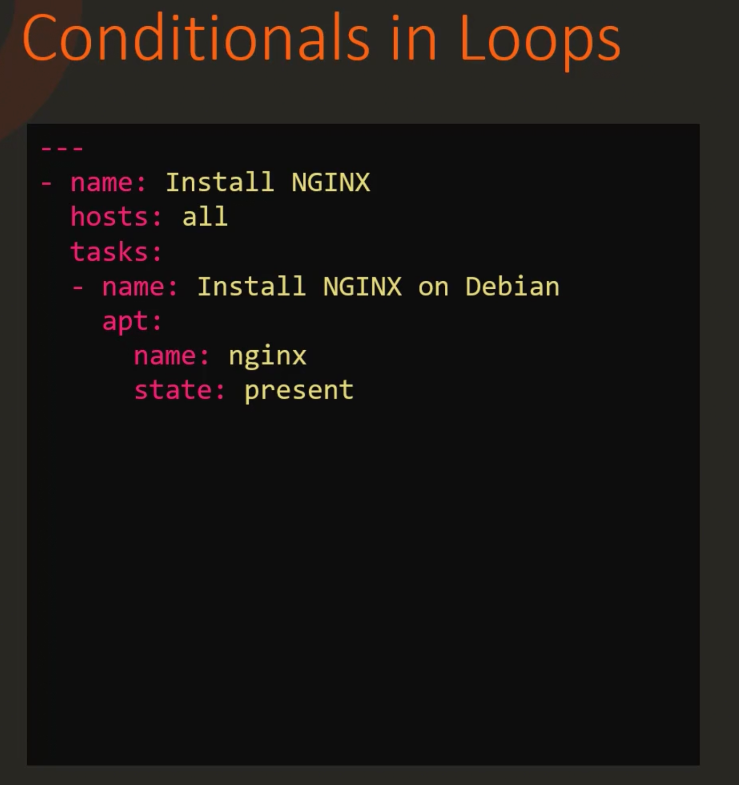
I want to Install a list of packages to my server.

Slide 55
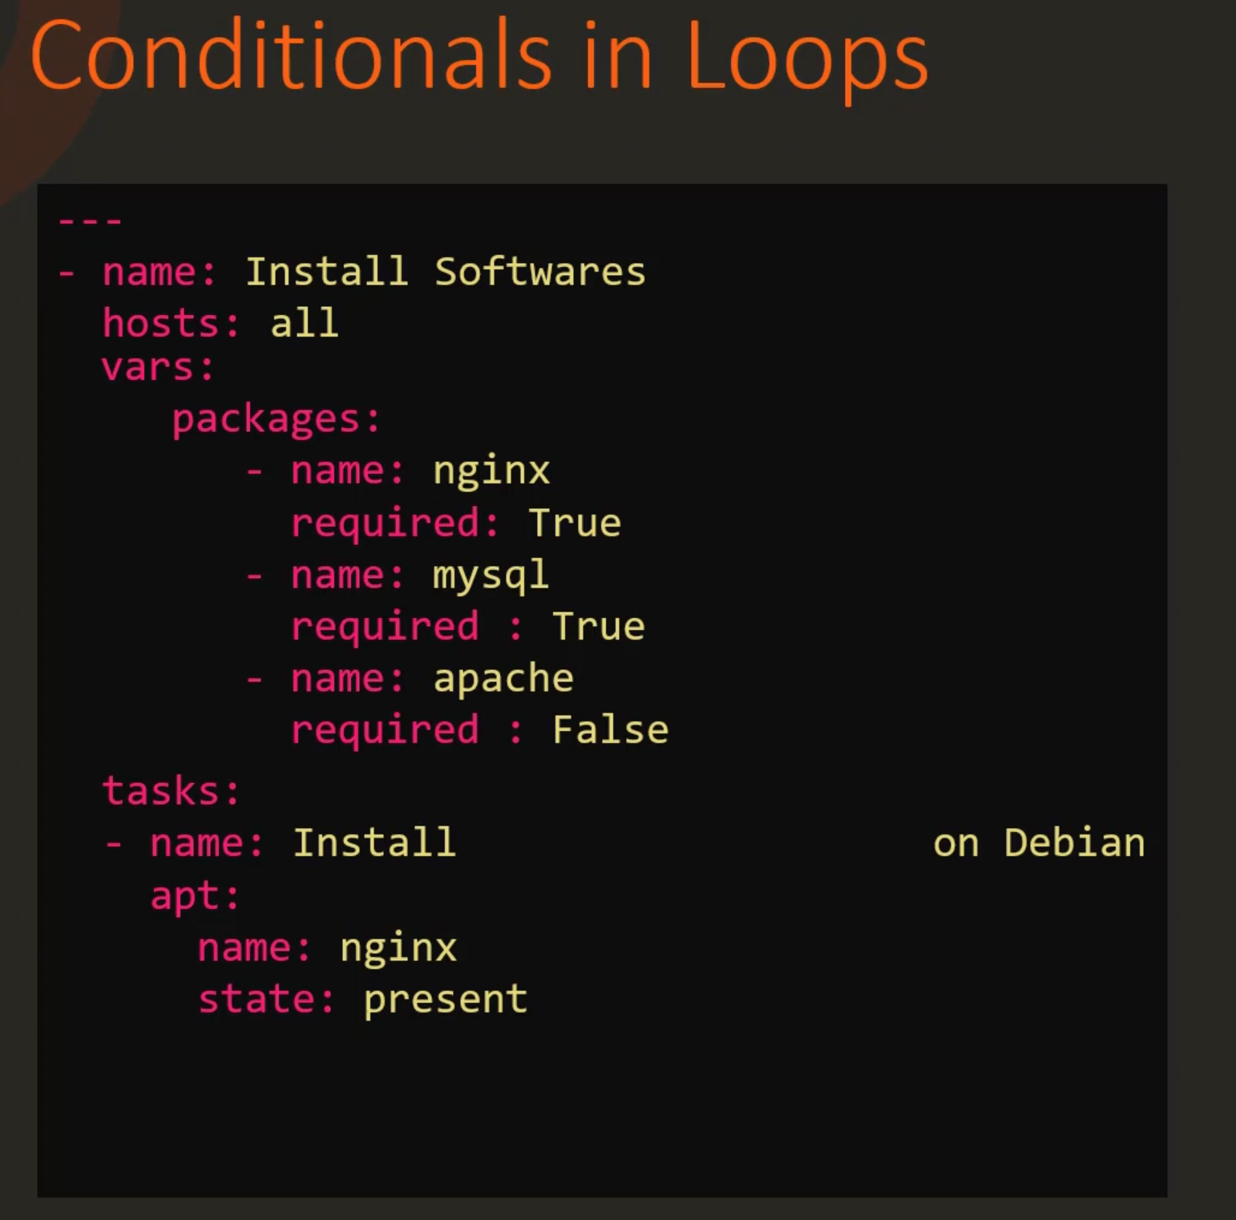
I have a list of packages in the variable called packages. I only want to install the package for which the variable ‘Required’ is marked as true.

Slide 56
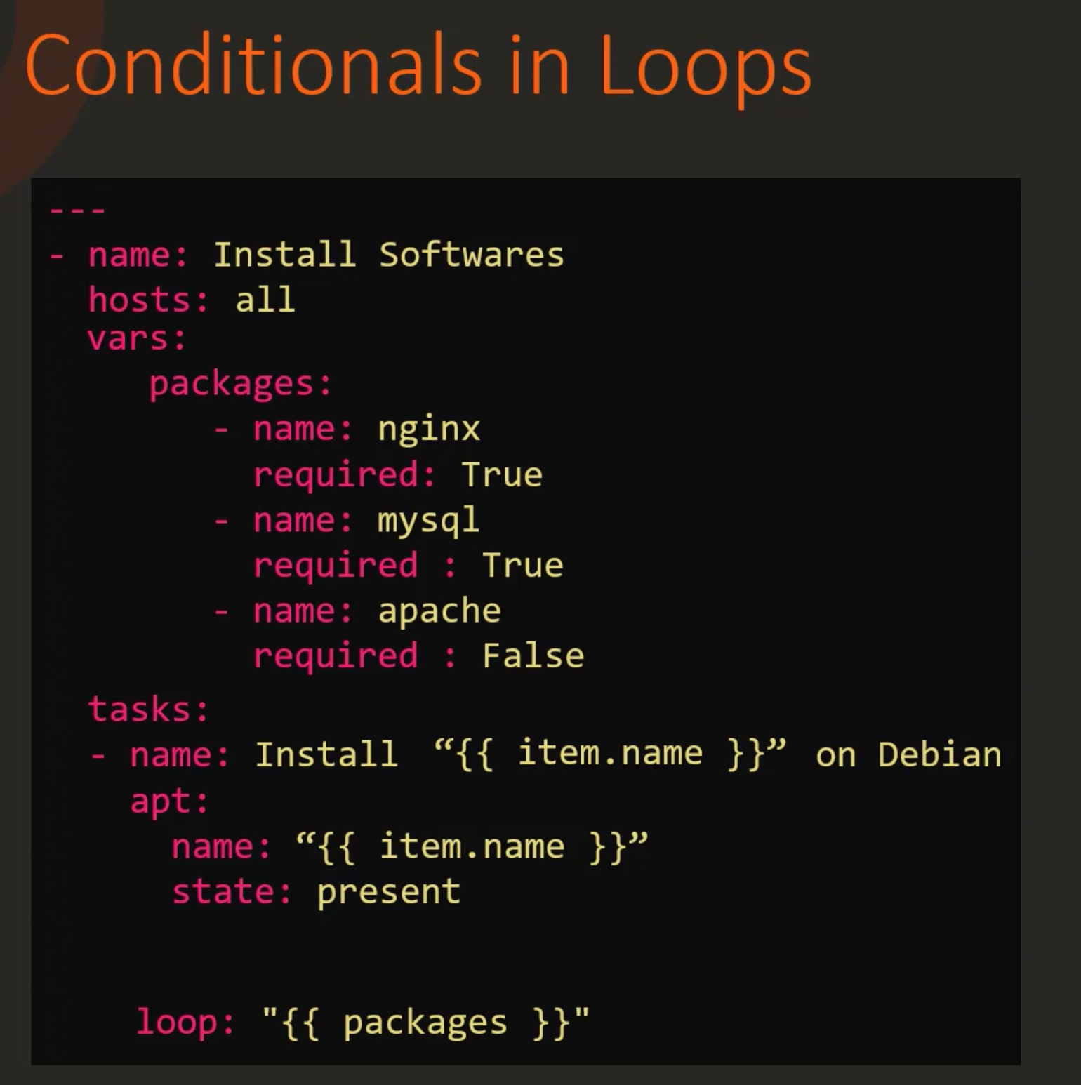
We specify the loop directive as shown in the image, and to specify the name of the package we use item.name as shown.
The following slide shows how the loop is realized -

Slide 57
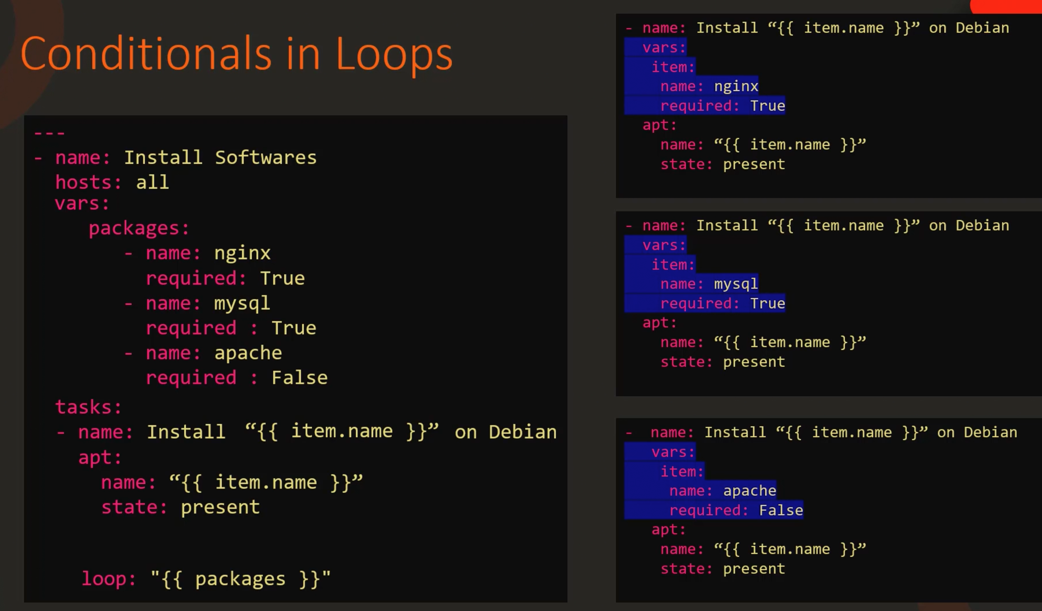
Ansible
Loops

Slide 58
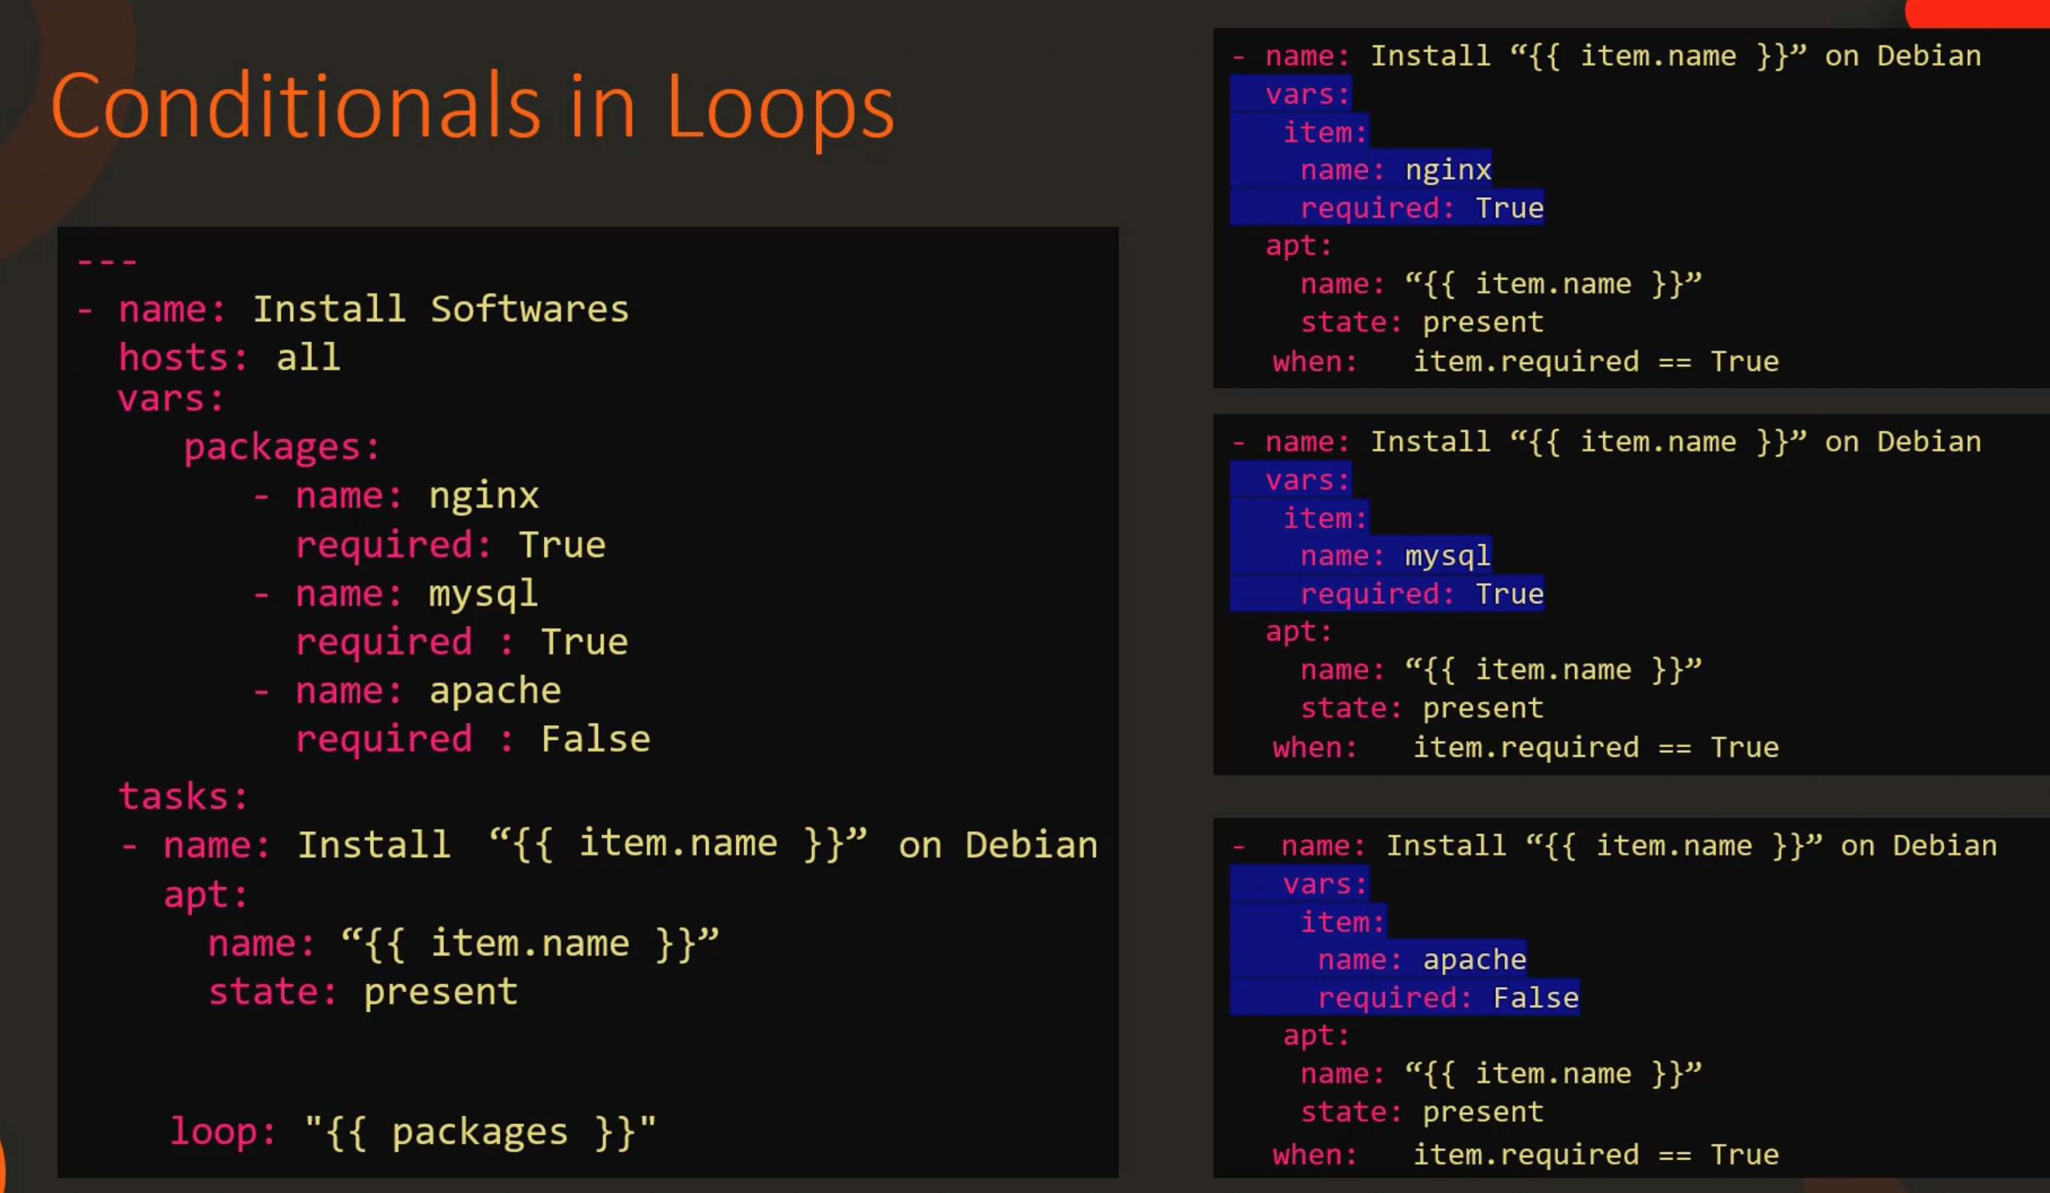

Slide 59
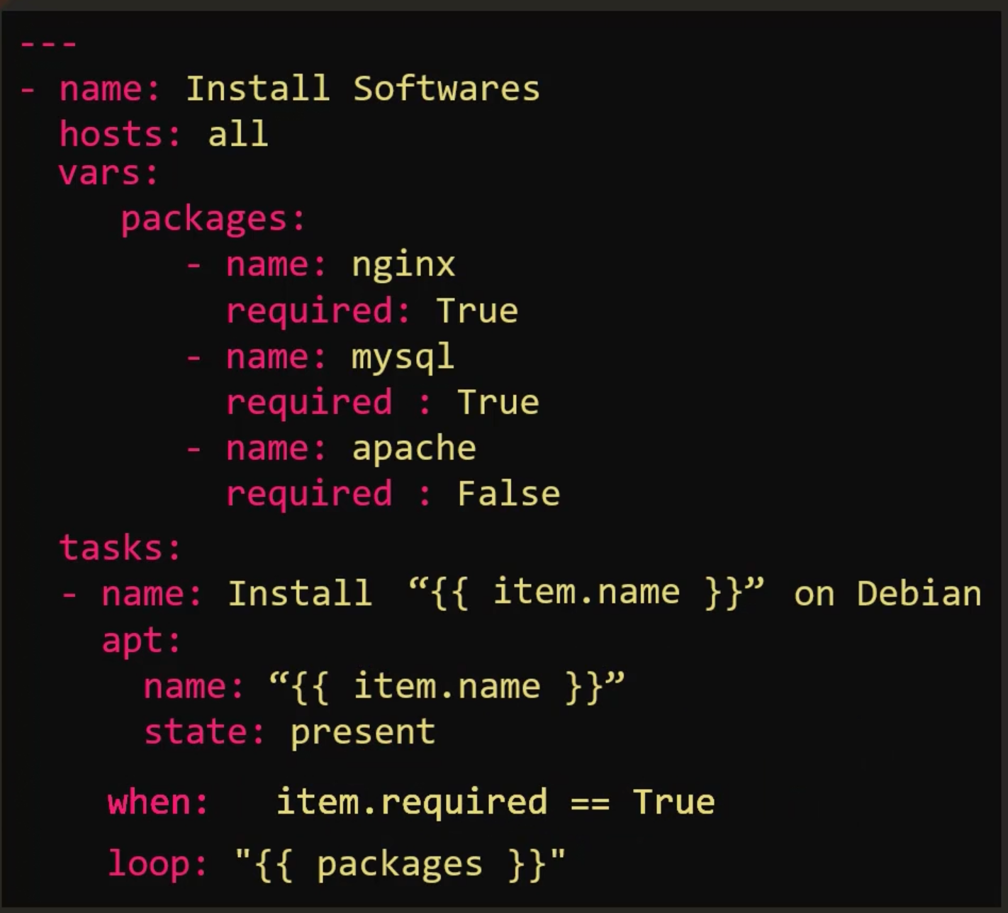
The final Playbook

Slide 60
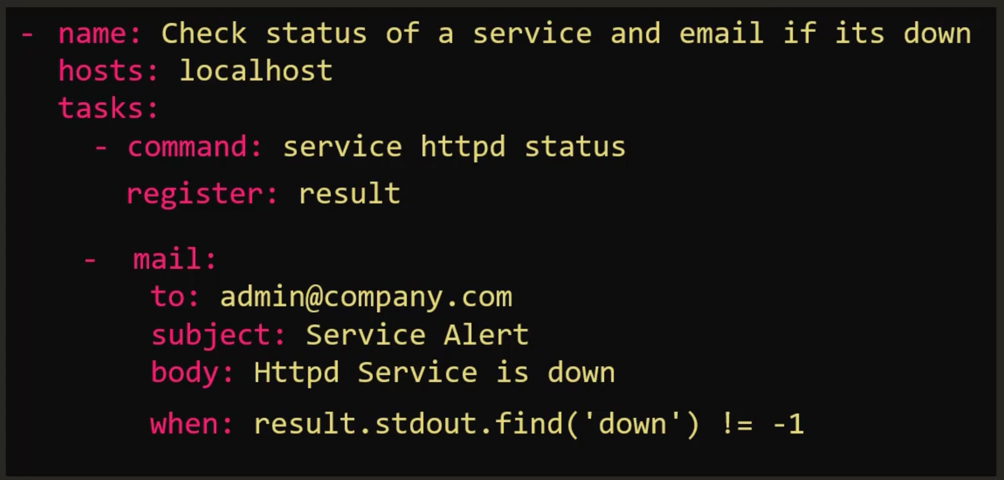
A more complicated playbook

Slide 61

Ansible
Roles

Slide 62
Doctor
Engineer
Astronaut
Police
Chef

Slide 63





Doctor
mysql
Engineer
nginx
Astronaut
redis
Police
backup
Chef
monitor

Slide 64

Doctor
mysql
Go to medical school
Earn medical degree
Complete Residency Program
Obtain License
Engineer
Go to engineering school
Earn bachelor’s degree
Gain field experience
Gain postgraduate degree
Installing Pre-requisites
Installing mysql packages
Configuring mysql service
Configuring database and users
nginx
Installing Pre-requisites
Installing nginx packages
Configuring nginx service
Configuring custom web pages

Slide 65

name: Install and Configure MySQL hosts: db-server
tasks:
name: Install Pre-Requisites
yum: name=pre-req-packages state=present
name: Install MySQL Packages yum: name=mysql state=present
name: Start MySQL Service service: name=mysql state=started
name: Configure Database mysql_db: name=db1 state=present
mysql
Installing Pre-requisites
Installing mysql packages
Configuring mysql service
Configuring database and users
nginx
Installing Pre-requisites
Installing nginx packages
Configuring nginx service
Configuring custom web pages

Slide 66

mysql
Installing Pre-requisites
Installing mysql packages
Configuring mysql service
Configuring database and users
Re-Use
- name: Install and Configure MySQL hosts: db-server1……db-server100 roles:
- mysql
MySQL-Role
tasks:
name: Install Pre-Requisites
yum: name=pre-req-packages state=present
name: Install MySQL Packages yum: name=mysql state=present
name: Start MySQL Service service: name=mysql state=started
name: Configure Database mysql_db: name=db1 state=present

Slide 67
mysql
Installing Pre-requisites
Installing mysql packages
Configuring mysql service
Configuring database and users
Organize
Re-Use
MySQL-Role
tasks
vars
handlers
tasks:
name: Install Pre-Requisites
yum: name=pre-req-packages state=present
name: Install MySQL Packages yum: name=mysql state=present
name: Start MySQL Service service: name=mysql state=started
name: Configure Database mysql_db: name=db1 state=present
mysql_packages:
mysql
mysql-server db_config:
db_name: db1
defaults
templates
mysql_user_name: root mysql_user_password: root

Slide 68
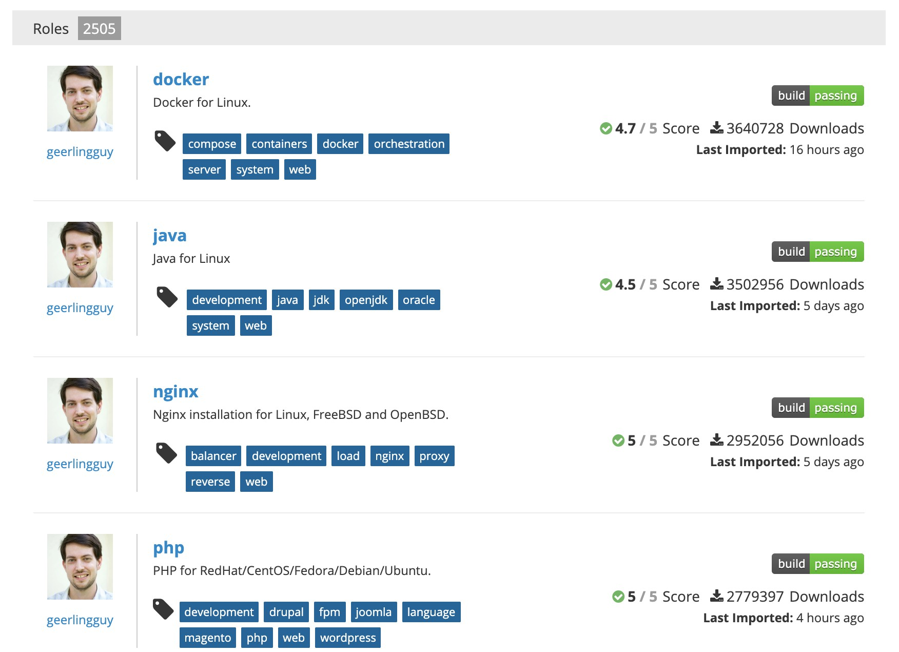
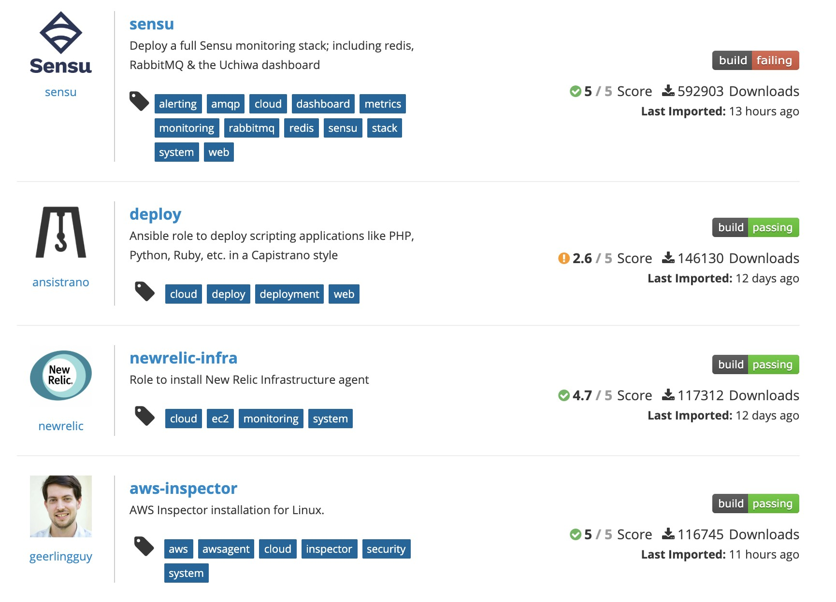
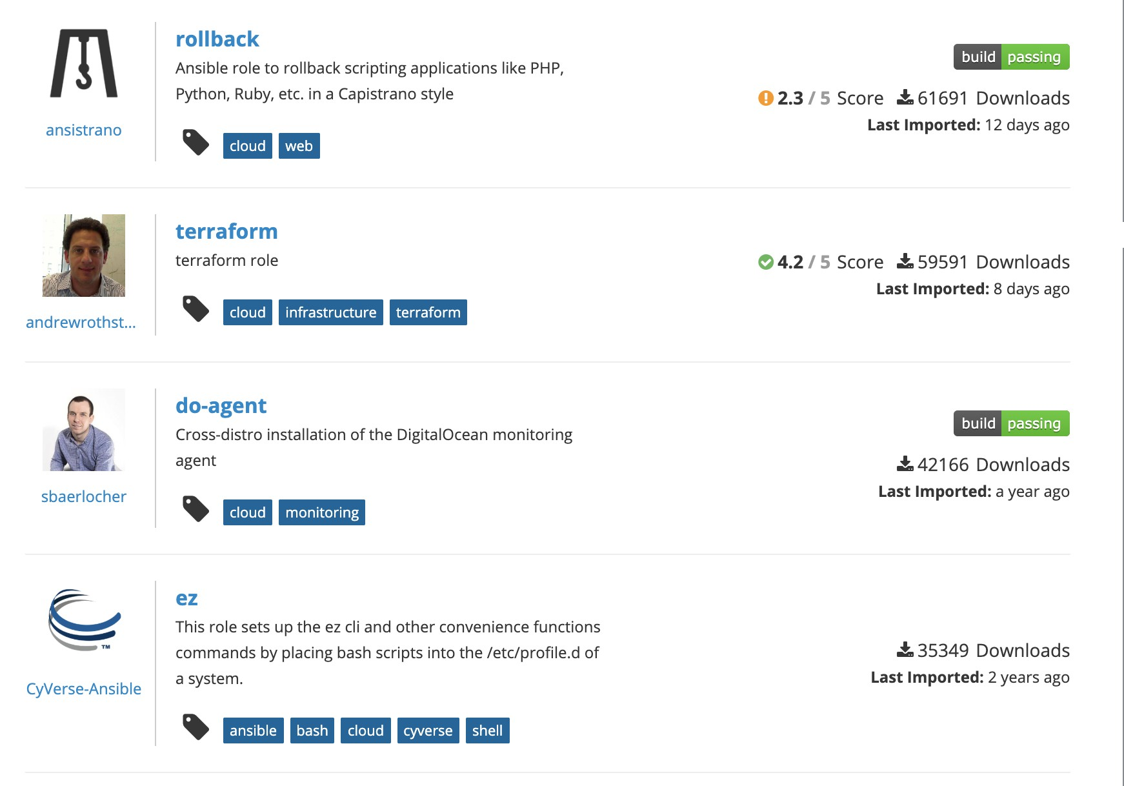
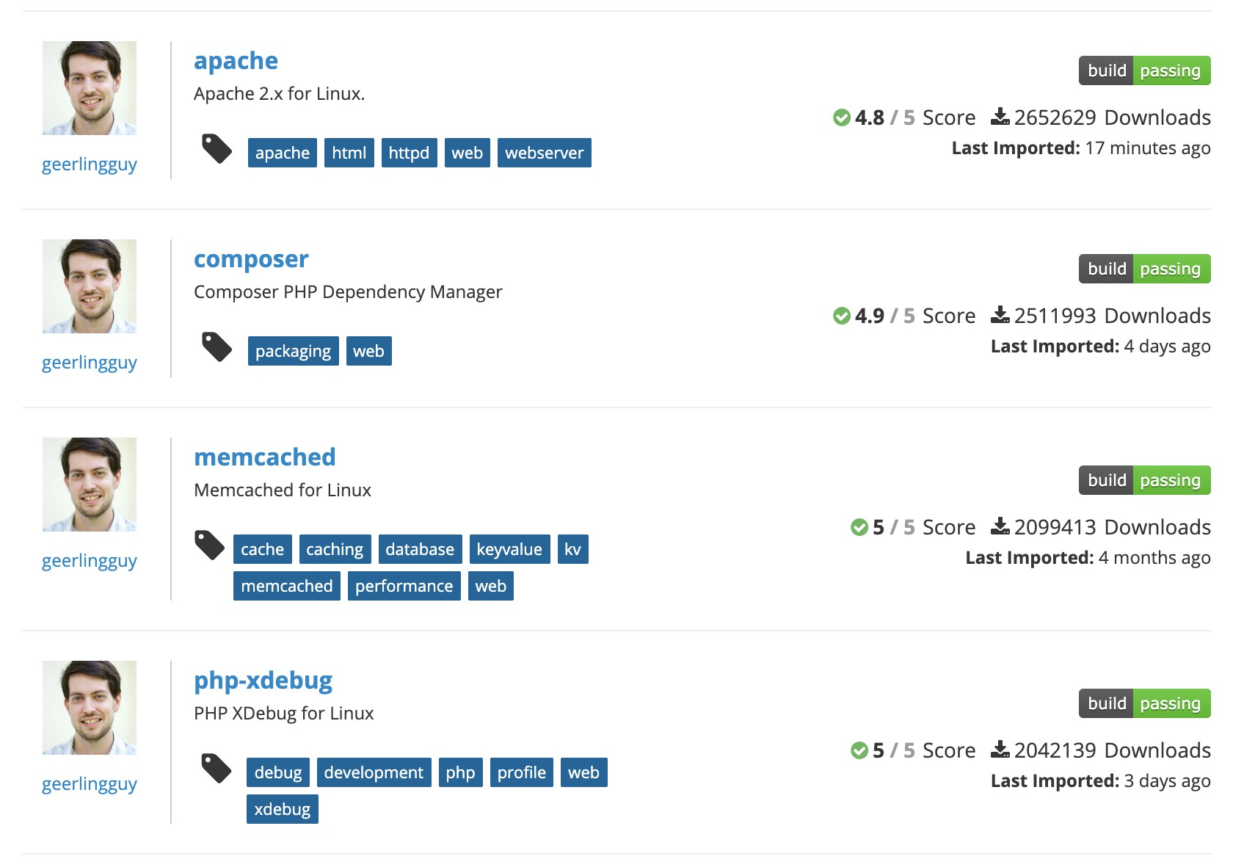

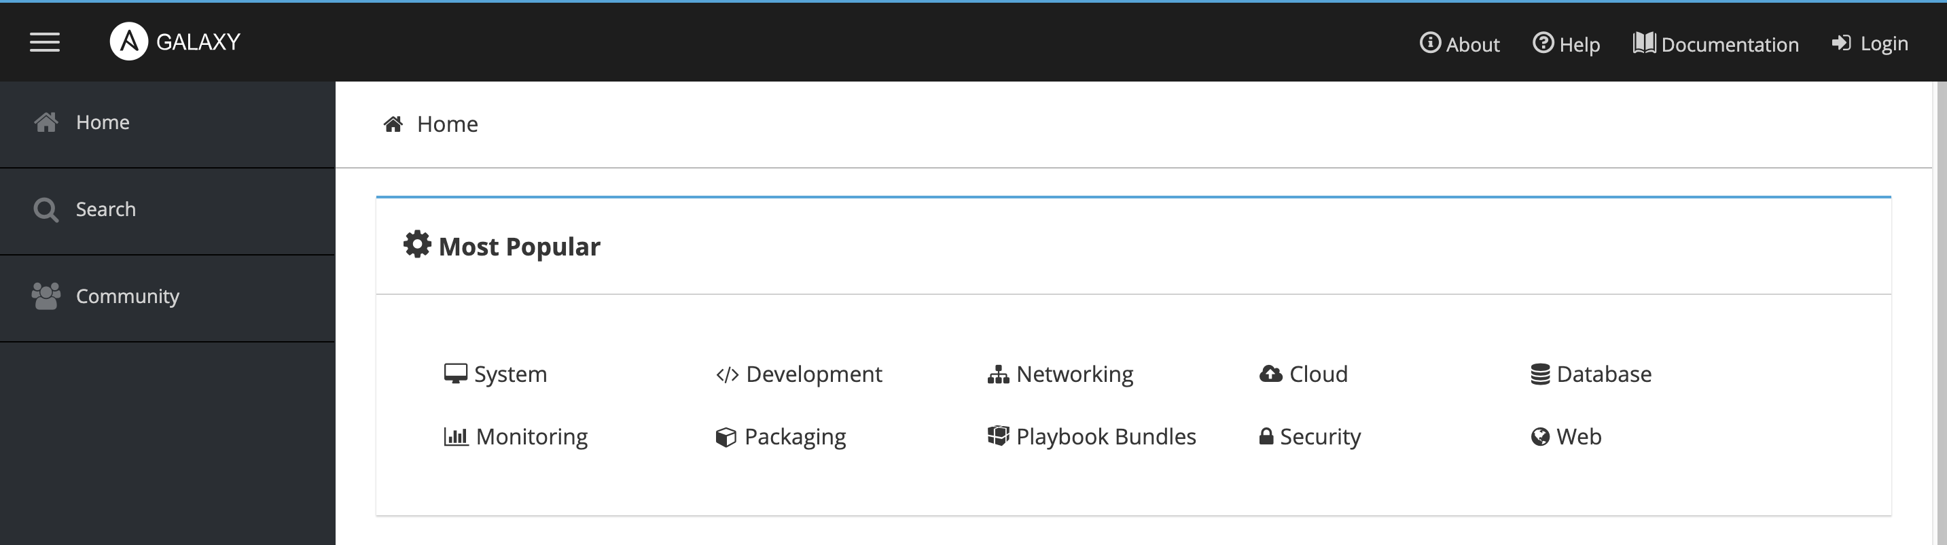
Organize
Re-Use
Share

Slide 69



Re-Use
Organize
Share
$ ansible-galaxy init mysql
playbook.yml
- name: Install and Configure MySQL hosts: db-server
roles:
- mysql
mysql
my-playbook
README.md
templates
tasks handlers
vars
defaults meta
playbook.yml
roles

Slide 70
Re-Use
Organize
Share
$ ansible-galaxy init mysql
playbook.yml
- name: Install and Configure MySQL hosts: db-server
roles:
- mysql
mysql
my-playbook
README.md
templates
tasks handlers
vars
defaults meta
playbook.yml
roles

Slide 71
Re-Use
Organize
Share
$ ansible-galaxy init mysql
playbook.yml
- name: Install and Configure MySQL hosts: db-server
roles:
- mysql
my-playbook
playbook.yml
roles
mysql
README.md
templates
tasks handlers
vars
defaults
meta
/etc/ansible/ansible.cfg
roles_path = /etc/ansible/roles

Slide 72

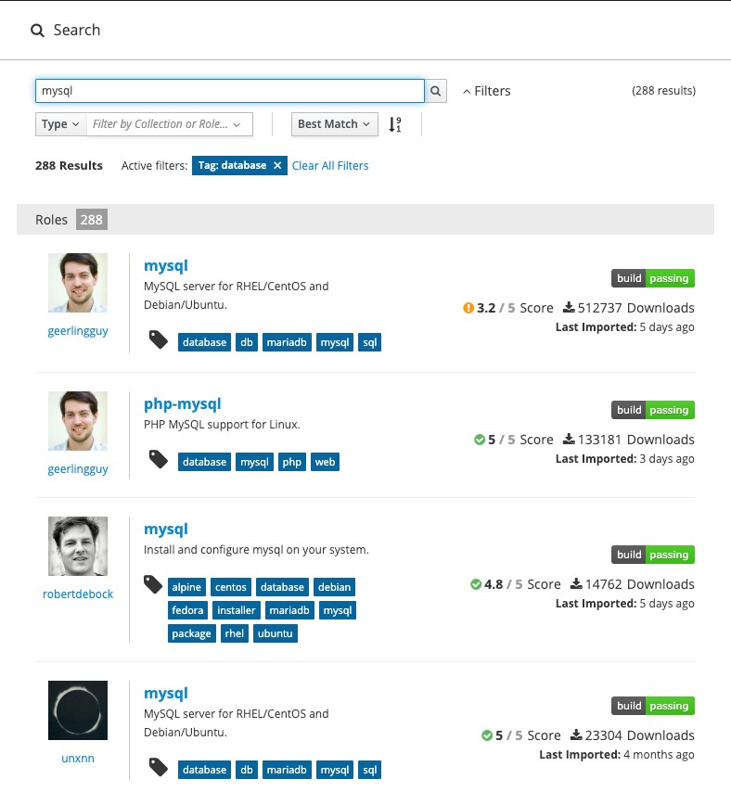


Find Roles
$ ansible-galaxy search mysql
Found 1126 roles matching your search. Showing first 1000.
Name Description
0utsider.ansible_zabbix_agent Installing and maintaining zabbix-agent for 1mr.unattended install and configure unattended upgrade
1nfinitum.mysql Simply installs MySQL 5.7 on Xenial. 4linuxdevops.mysql-server Instalacao e Configuracao do servidor MySQL 5KYDEV0P5.skydevops-mysql Install and configure MySQL Database AAbouZaid.yourls Manage Yourls, a URL shortener web app.
AAROC.AAROC_fg-db your description
aaronpederson.ansible-autodeploy Simple deployment tool with hooks abednarik.mysqld-exporter Install and configure mysqld_exporter abelboldu.openstack-glance
abelboldu.openstack-keystone
abelboldu.openstack-neutron-controller OpenStack Neutron controller node abelboldu.openstack-nova-controller OpenStack Nova controller node achaussier.mysql-backup configure mysql-backup with xtrabackup and achaussier.mysql-server Install mysql-server package
achilleskal.ansible_mysql8 your description
adarnimrod.mysql Provision a MySQL server

Slide 73



Use Role
$ ansible-galaxy install geerlingguy.mysql
downloading role 'mysql', owned by geerlingguy
downloading role from https://github.com/geerlingguy/ansible-role-mysql/archive/2.9.5.tar.gz
extracting geerlingguy.mysql to /etc/ansible/role
geerlingguy.mysql (2.9.5) was installed successfully
/etc/ansible/roles/lgeerlingguy.mysql
s/geerlingguy.mysq
playbook.yml
-
-
name: Install and Configure MySQL hosts: db-server
roles:
- role: geerlingguy.mysql become: yes
vars:
mysql_user_name: db-user
name: Install and Configure MySQL hosts: db-server
roles:
- geerlingguy.mysql

Slide 74



Use Role
Playbook-all-in-one.yml
Playbook-distributed.yml
-
name: Install and Configure MySQL hosts: db-and-webserver
roles:
geerlingguy.mysql
nginx
-
name: Install and Configure MySQL hosts: db-server
roles:
geerlingguy.mysql
name: Install and Configure Web Server hosts: web-server
roles:
nginx
-
mysql
mysql
nginx

Slide 75
List Roles
$ ansible-galaxy list
geerlingguy.mysql
kodekloud1.mysql
$ ansible-config dump | grep ROLE
EFAULT_PRIVATE_ROLE_VARS(default) = False
DEFAULT_ROLES_PATH(default) =
[u'/root/.ansible/roles', u'/usr/share/ansible/roles', u'/etc/ansible/roles']
GALAXY_ROLE_SKELETON(default) = None GALAXY_ROLE_SKELETON_IGNORE(default) = ['^.git$', '^.*/.git_keep$']
$ ansible-galaxy install geerlingguy.mysql –p ./roles

Slide 76
A bit more on ansible
The following content is for deeper understanding of ansible. Before moving into that, make sure you have thoroughly understood the core concepts. The following concepts will build better depth into the subject matter.

Slide 77
Ansible Configurations
Stored in /etc/ansible/ansible.cfg
Contains sections like – defaults,inventory, privilege_escalation, paramiko_connection, ssh_connection, persistent_connection, colors etc.

Slide 78
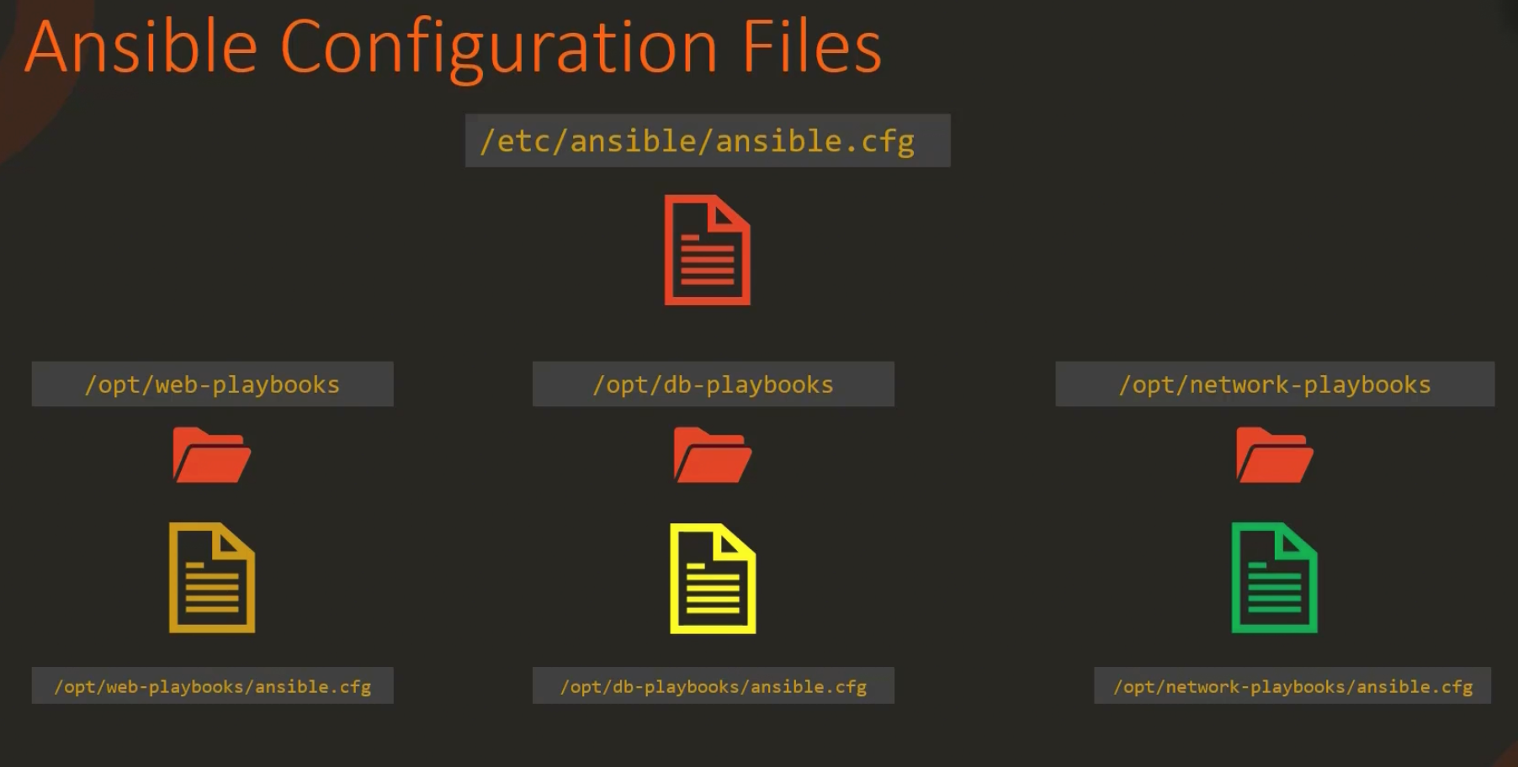
Overriding Default Parameters
If you need different config options for different playbooks, you can keep a local copy of the configuration with the necessary definitions.
You can also specify the ANSIBLE_CONFIG environment var.

Slide 79
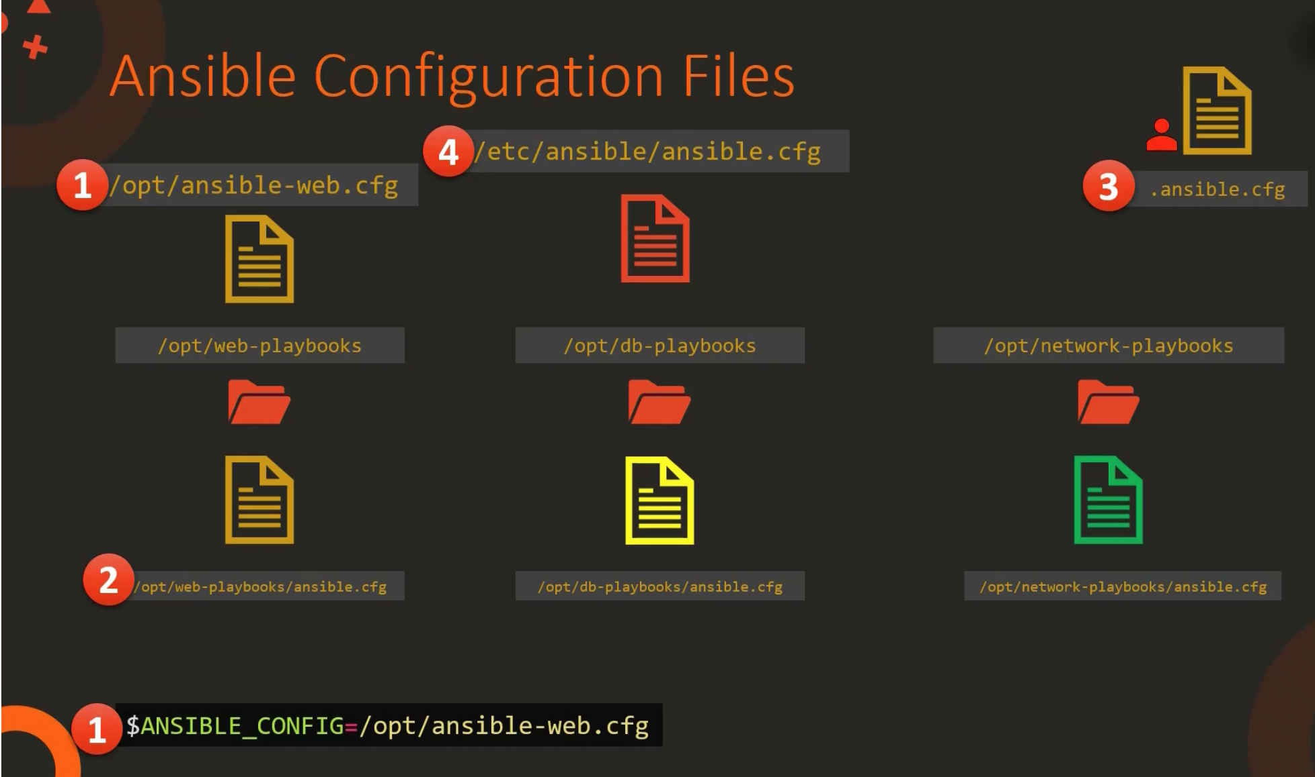
Ansible config priority chain
1. Environment Path
2. Current Directory
3. .ansible.cfg in /usr/home directory
4. etc/ansible/ansible.cfg

Slide 80
View ansible configurations
ansible-config list # Lists all configuration
ansible-config view # shows current configuration
ansible-config dump # Shows current configurations including where it is being picked from

Slide 81

Types of inventory & Grouping

Slide 82
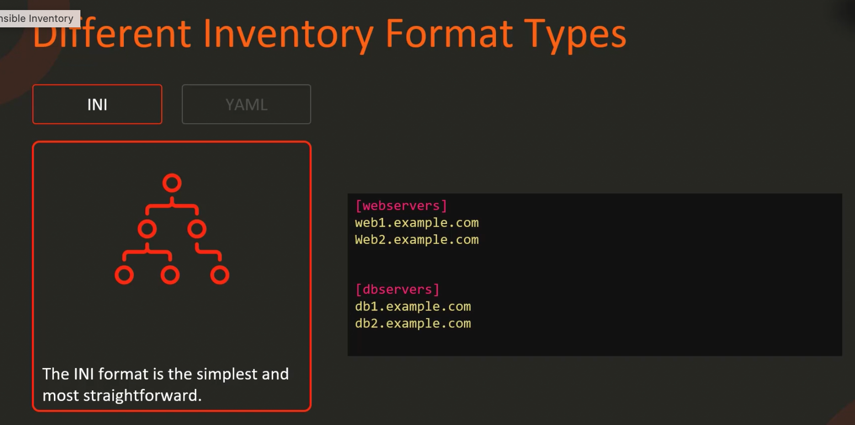
Types of Inventory - ini

Slide 83
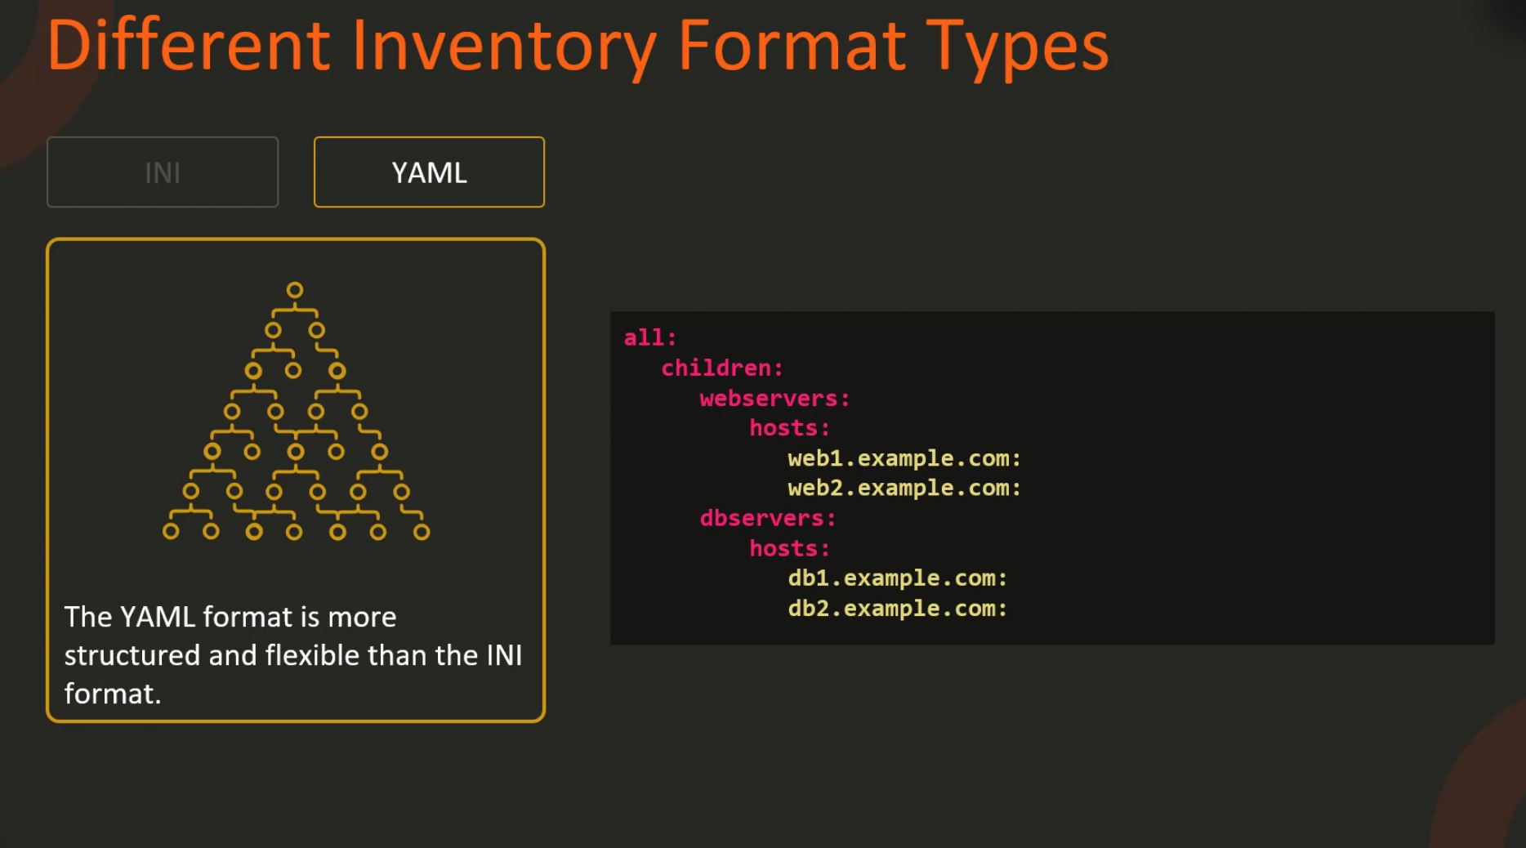
TYPES OF INVENTORY - YAML

Slide 84
grouping of servers
Why?
For enabling the ease of targeting servers.

Slide 85
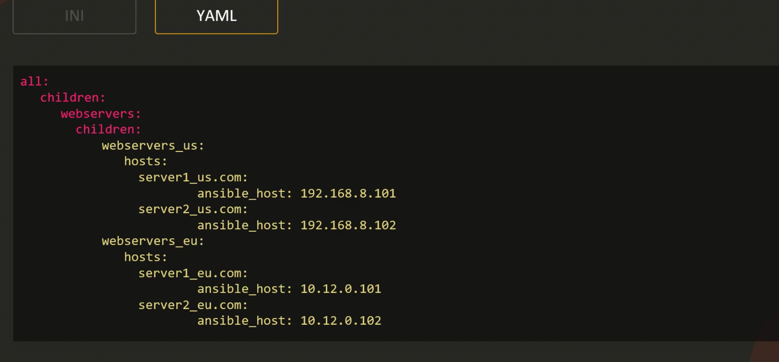
Grouping of servers in yaml

Slide 86
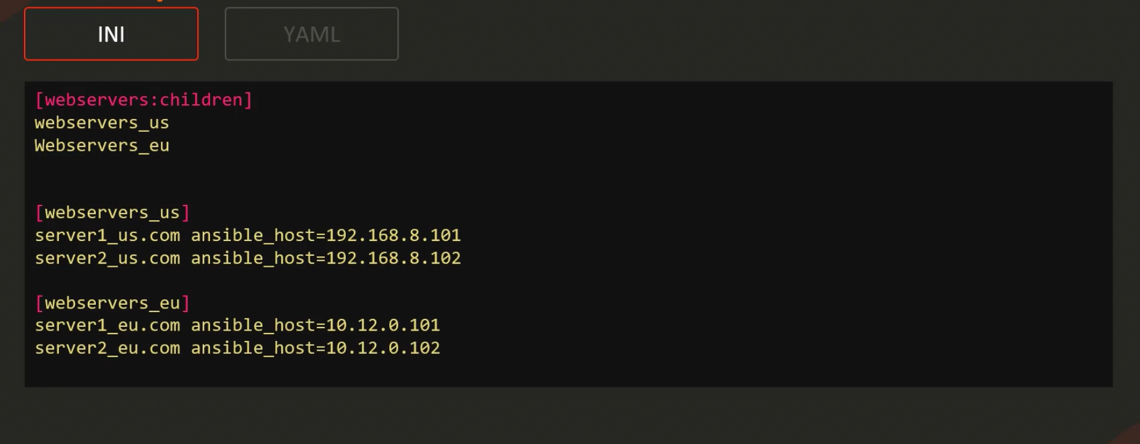
Grouping of servers - ini

Slide 87
Ansible FACTS
Ansible gathers facts before running any task on the target hosts.
01
- name: Some Play hosts: all tasks: - debug: var: ansible_facts
02
Use the above code to print the gathered facts. To disable fact gathering, use gather_facts: no
03

Slide 88
Ansible playbook verification
Check Mode : ansible-playbook –i inventory playbook.yaml –check
1
Diff Mode : ansible-playbook –i inventory playbook.yaml –check –diff
2
Syntax Check Mode : ansible-playbook –i inventory playbook.yaml –syntax-check
3

Slide 89
Ansible Lint
Get valuable information using ansible lint
Gives you data about style issues and about deprecated modules in code.
pip3 install ansible-lint ansible-lint playbook.yml

Slide 90
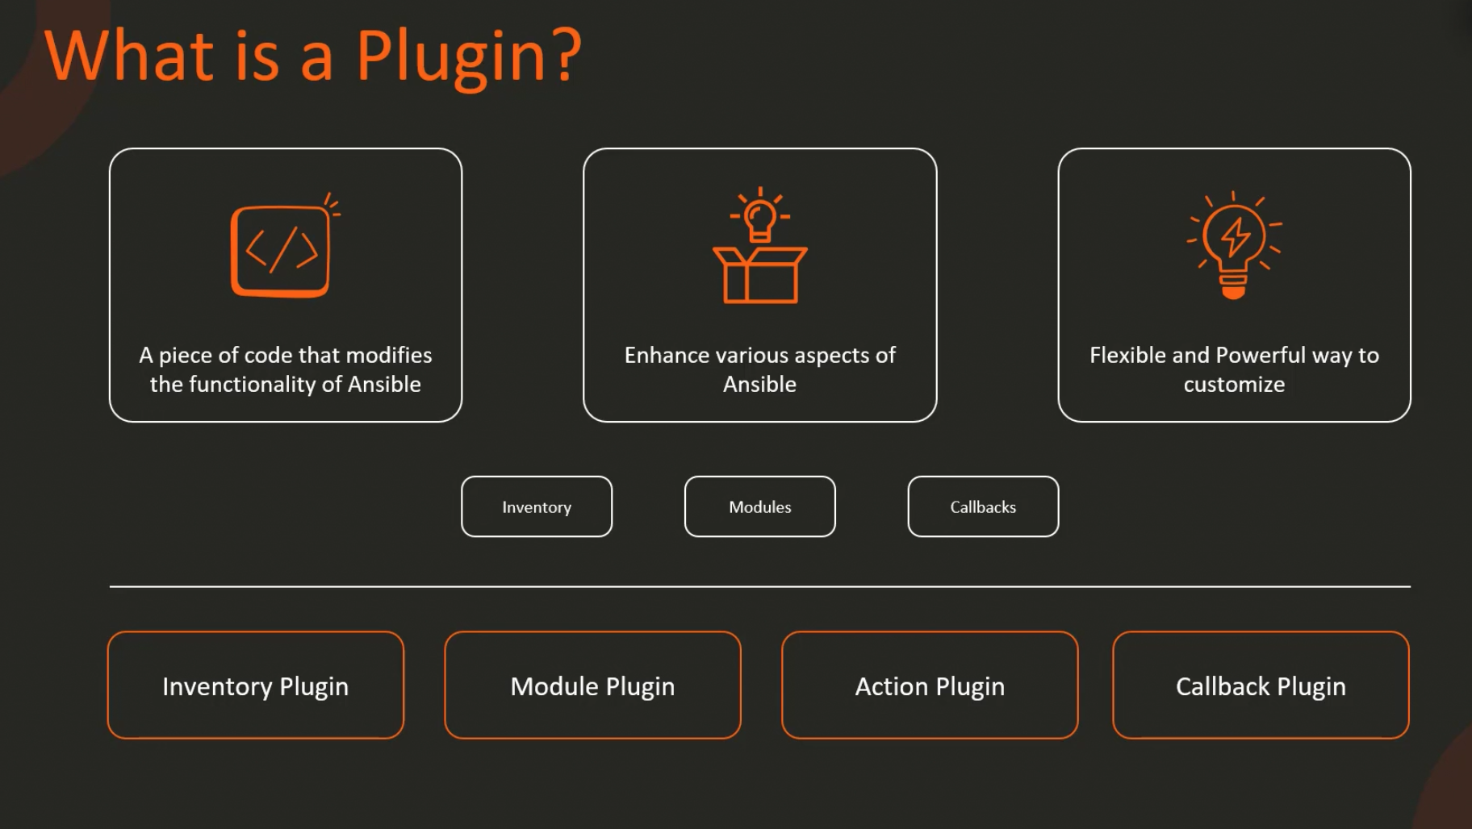
Ansible Plugin
Dynamic Inventory Plugin
Module Plugin – Integraetes with Cloud API
Action Plugin – LB management
Lookup Plugin – Similar to Datasources
Filter Plugin - Format Output
Connection Plugin – ssh, winrm etc.

Slide 91
How to create a dynamic inventory
Create
Create a file aws_ec2.yaml Contents shown in next slide
Open
vi /etc/ansible/ansible.cfg & under [inventory]
enable_plugins = aws_ec2, yaml, ini, auto
Check
Check if boto3 and botocore exist : python2.7 -c "import boto3, botocore"
RUN
sudo easy_install pip
RUN
sudo pip2.7 install boto3

Slide 92
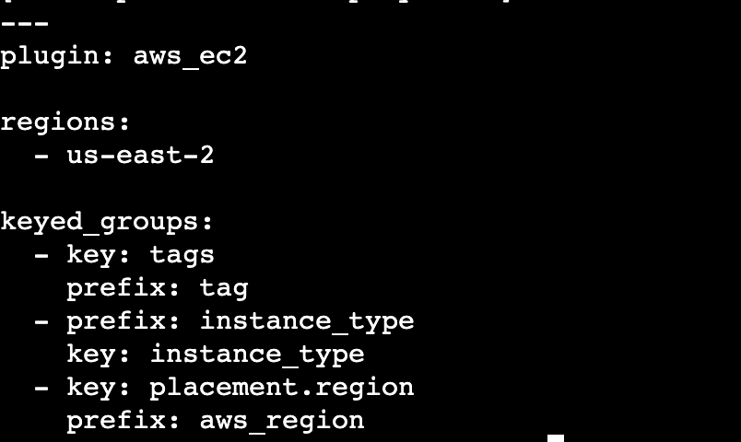
Contents of aws_ec2.yaml

Slide 93
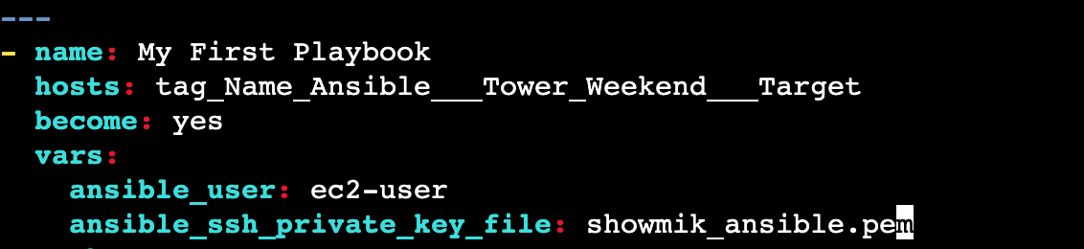
Ansible vars to be added

Slide 94
The final task
The usage of the pem file is not safe.
To go around this problem we should generate a new public and private key using ssh-keygen command.
Then we have to copy over the public key to our target host/hosts.
Use the following command to copy the public key: ssh -i showmik_ansible.pem ec2-user@<TARGET_IP> 'cat ~/id_rsa.pub >> ~/.ssh/authorized_keys && rm ~/id_rsa.pub'

